Slide 1


Department of ICT
A project(major) Final defense on:
“TRAFFIC SIGN DETECTION IN NEPAL USING RCNN”
Project Members:
Abhishek Joshi 200302
Prashant Phuyal 200324
Prashant Shrestha 200325
Bed Prakash shah 200344
Submitted to:
Department of ICT
Cosmos College of Management and Technology
Date : 23 July 2025

Slide 2
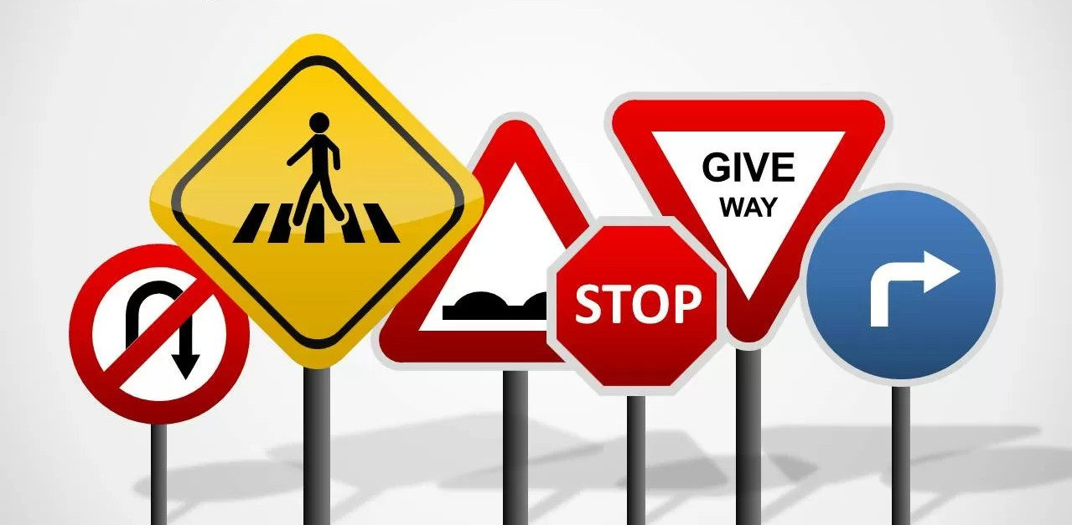
Traffic Sign Detection
Traffic sign detection is a computer
vision technique used to identify
and recognize road signs from
images.
It plays a vital role in modern
transportation systems, especially
for driver assistance and
autonomous vehicles

Slide 3
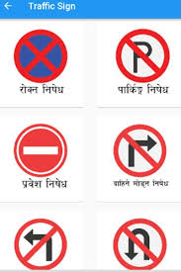
Introduction to Traffic Sign Detection in Nepal
Traffic sign detection is essential for improving road safety and traffic management in Nepal.
Rapid urbanization and diverse traffic environments pose challenges for traditional detection methods.
Employing advanced deep learning techniques like RCNN can enhance detection accuracy and reliability.

Slide 4
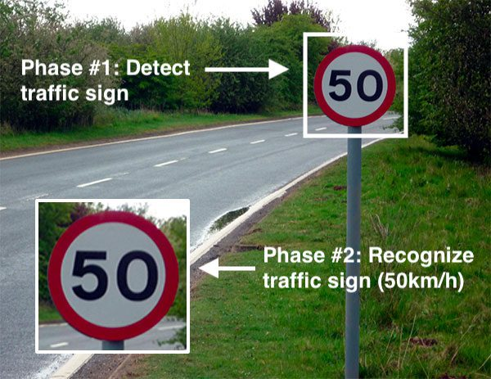
Objective of the Project
Develop a deep learning-based system to detect Nepalese traffic signs.
Improve road safety using automated sign recognition.
Create a dataset of Nepal-specific traffic signs.

Slide 5
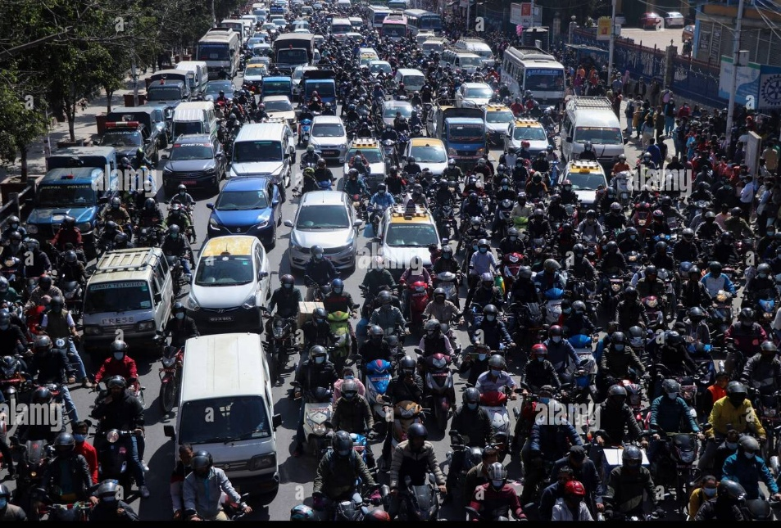
Importance of Traffic Sign Detection in Nepal
Accurate detection helps reduce accidents caused by missed or misunderstood signs.
It supports the development of intelligent transportation systems tailored for Nepal’s unique roads.
Enhanced sign detection can assist autonomous vehicles and driver-assistance systems in Nepalese traffic conditions.

Slide 6
Tools and Equipment
Hardware = laptop with Intel processor i5 or more.
Software::
Frontend= React
Backend=Python
Documentation=Ms-Office
IDE=Google Colab (Collaborator), Vs code

Slide 7
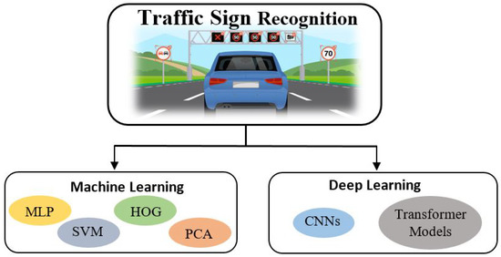
Literature Review
Previous studies used SVM, HOG, and CNN for sign detection.
YOLO and SSD models achieved real-time performance.
RCNN provides higher accuracy at the cost of speed.
Few studies focused on South Asian traffic sign datasets.

Slide 8
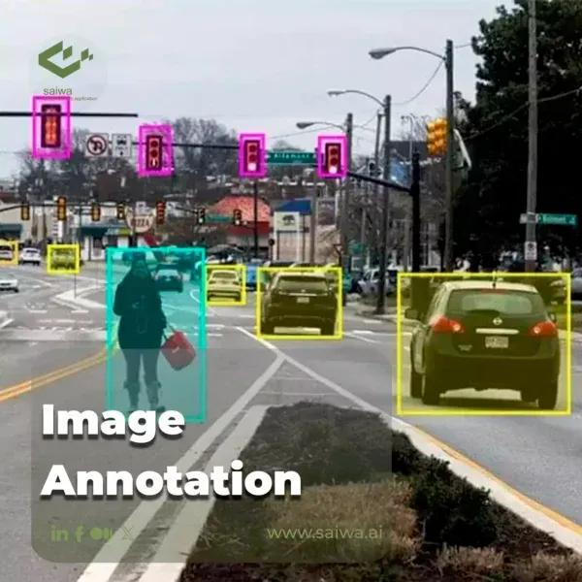
Data Annotation Tools Used
Used Labelme for manual bounding box annotation.
Saved annotations in .Jason format.
Focused on clarity and accuracy of labeling.
Ensured representation of different sign types and conditions.

Slide 9
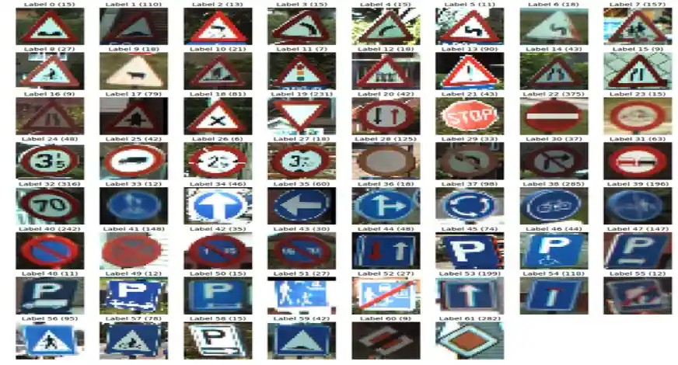
Dataset Collection and Preparation
Data was collected from various Nepalese roads, capturing different traffic sign types and conditions.
Images were annotated with bounding boxes and labels for training the RCNN model.
Data augmentation techniques were applied to increase dataset diversity and robustness.

Slide 10
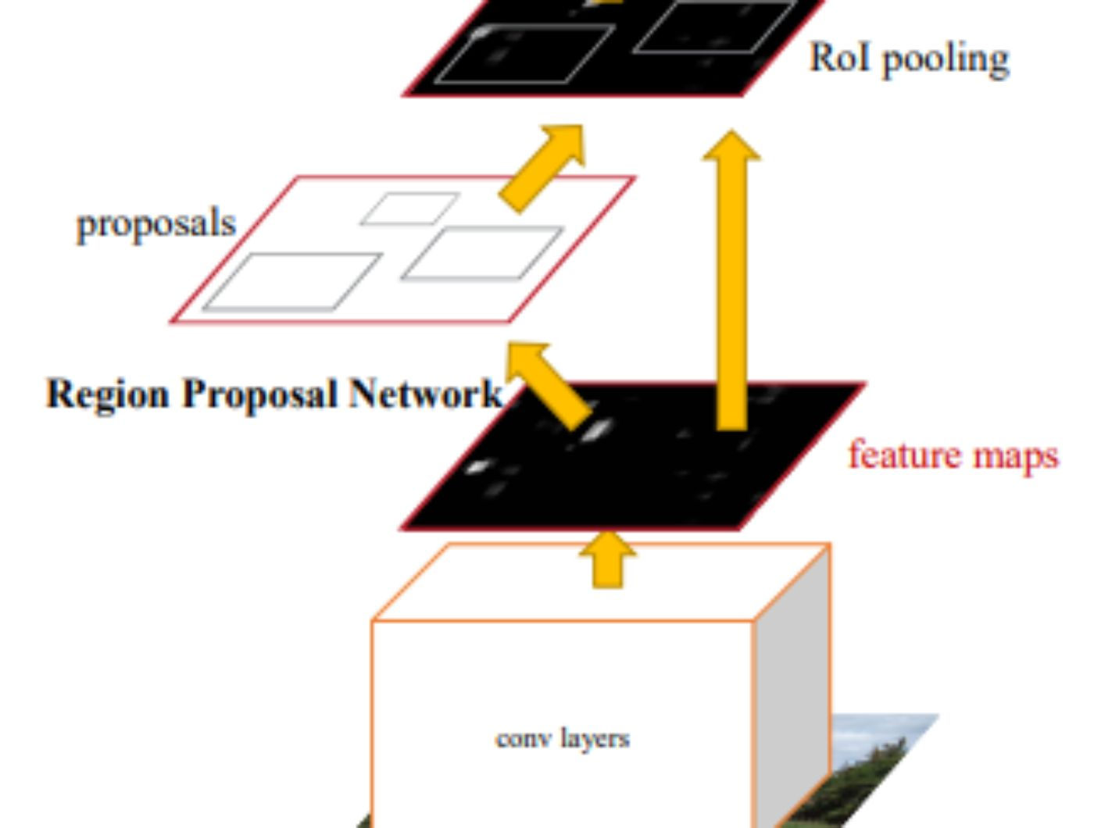
Overview of RCNN (Region-based Convolutional Neural Network)
RCNN is a deep learning framework designed for accurate object detection tasks.
It combines region proposal algorithms with convolutional neural networks for precise localization.
RCNN has been widely successful in various object detection applications, including traffic signs.

Slide 11
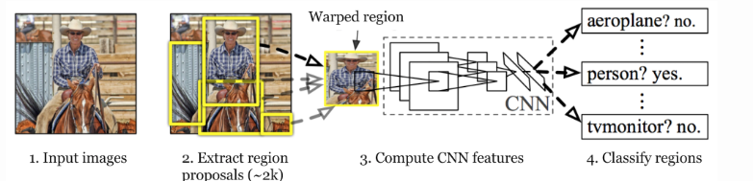
RCNN Architecture in Detail
Selective Search proposes candidate object regions.
CNN extracts features from each region.
SVM classifies each region regression refines bounding boxes.
Combines region proposal with deep feature learning.

Slide 12
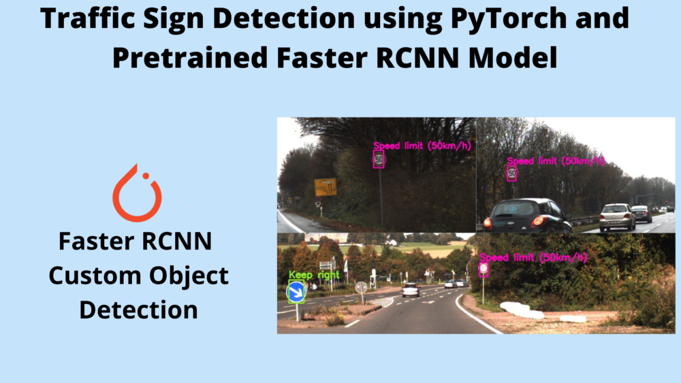
Why Use RCNN for Nepalese Traffic Sign Detection
RCNN’s high accuracy makes it suitable for complex and diverse traffic sign environments.
Its ability to generate region proposals helps detect small and partially occluded signs.
RCNN can be fine-tuned with Nepal-specific datasets to adapt to local traffic sign characteristics.

Slide 13
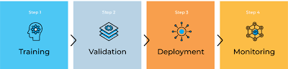
Model Training and Implementation
The RCNN model was trained using transfer learning on a pre-existing convolutional neural network backbone.
Hyperparameters such as learning rate, batch size, and epochs were optimized for best performance.
The trained model was validated on separate test data to evaluate detection accuracy and speed.

Slide 14
Results and Accuracy
Achieved mean Average Precision (mAP) of 93%.
Precision: 96%, Recall: 94%.
Effective in detecting partially occluded signs.

Slide 15
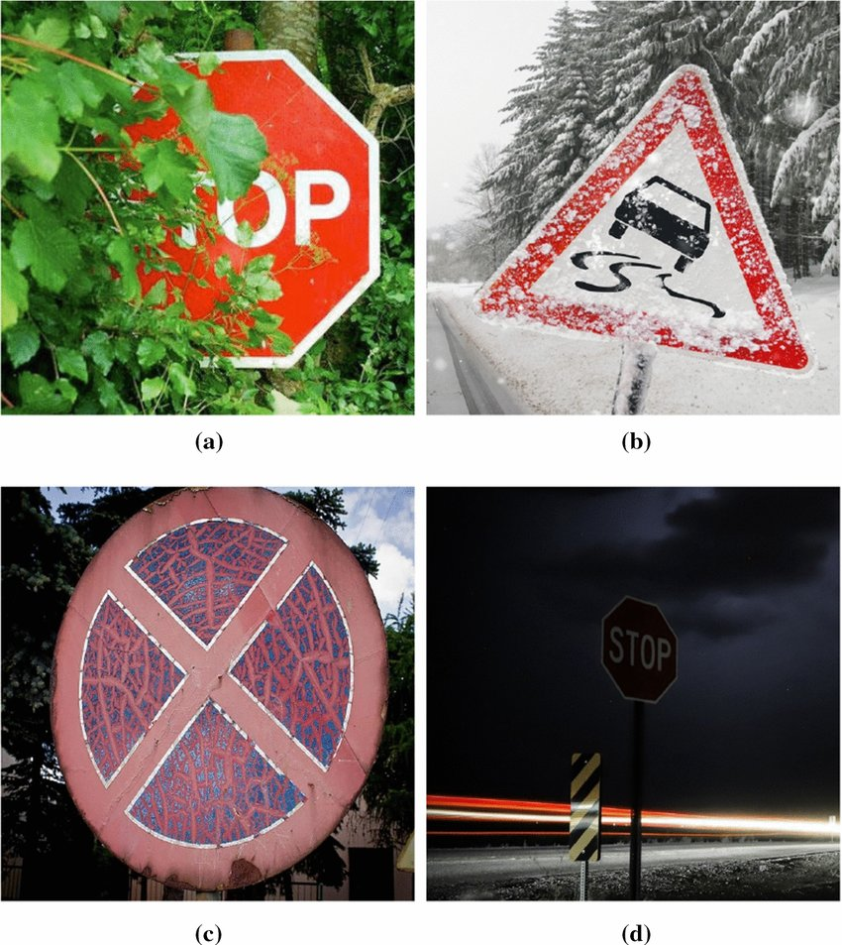
Limitations of the Project
Limited dataset size affects generalization.
Detection slows down on low-performance hardware.
Misclassification under poor lighting and visibility conditions.
No integration with real-time traffic monitoring yet.

Slide 16
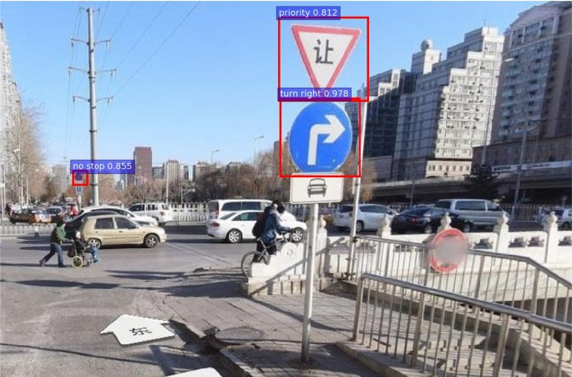
Real-world Applications
Driver-assistance systems for Nepalese vehicles.
Traffic violation detection and reporting.
Support for autonomous vehicle navigation.
Smart city traffic infrastructure enhancement.

Slide 17

Future Work and Recommendations
Expanding the dataset with more diverse and challenging traffic sign images is essential.
Integrating the RCNN-based system with existing traffic monitoring infrastructure can be beneficial.
Further research should explore lightweight models for deployment on resource-constrained devices.

Slide 18
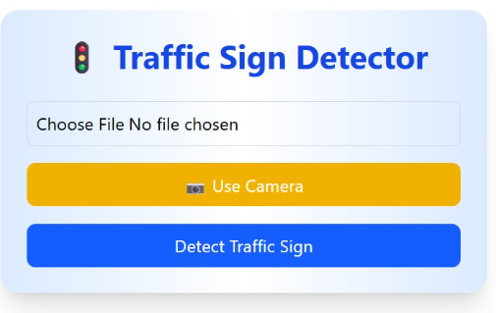
Work Completed

Slide 19
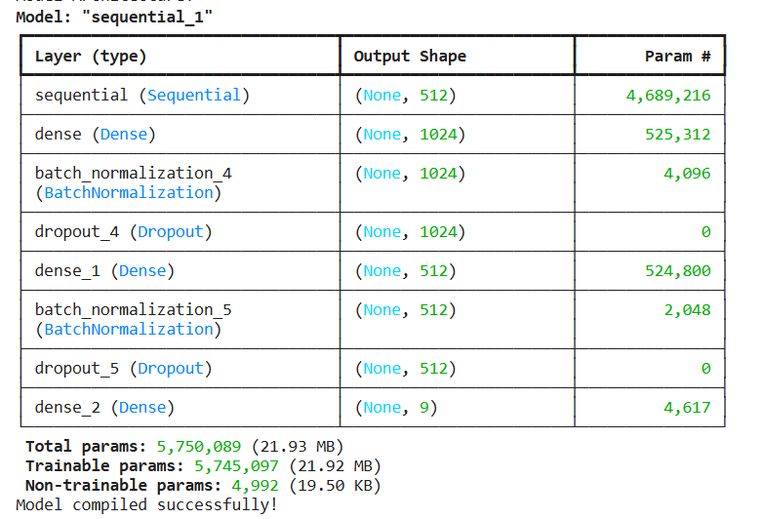
Work Completed

Slide 20
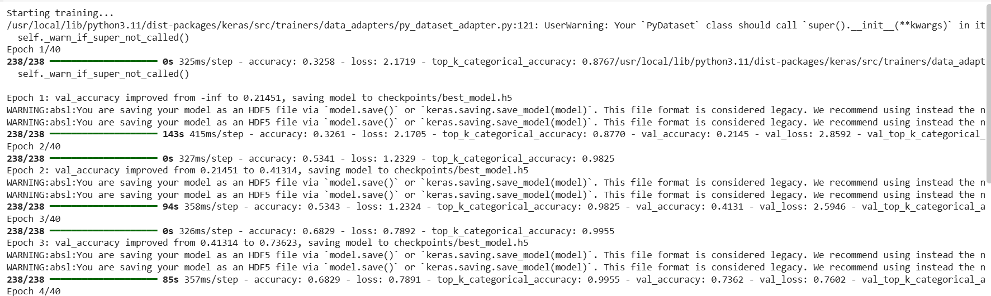
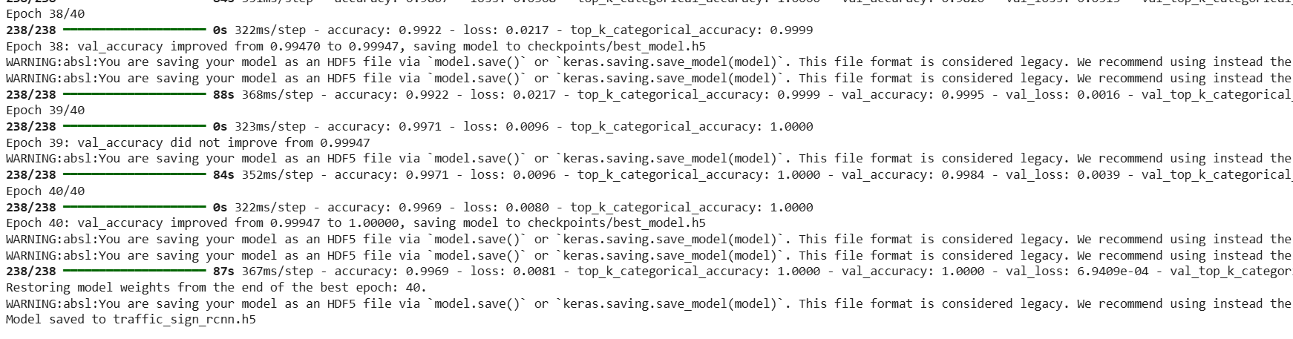
Work Completed

Slide 21
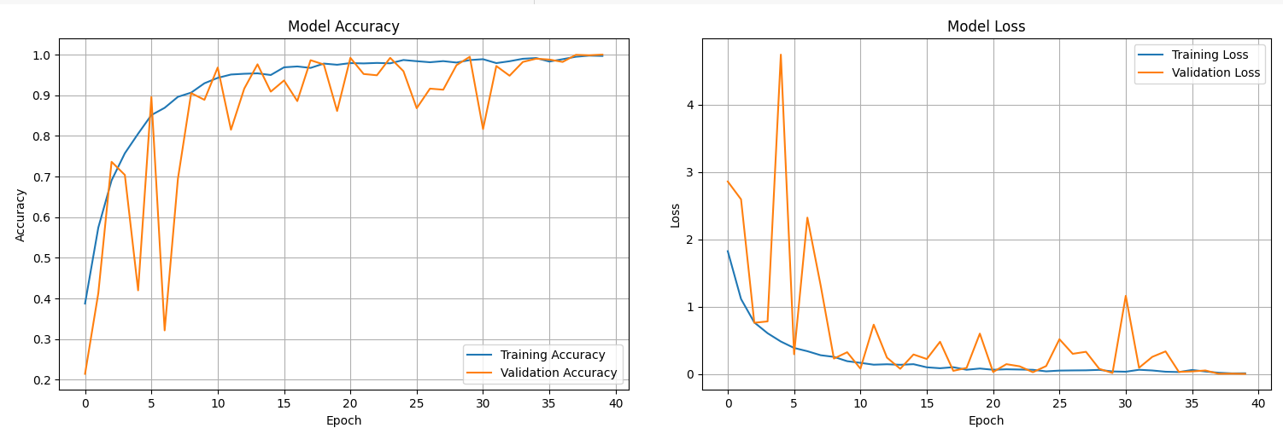
Work Completed

Slide 22
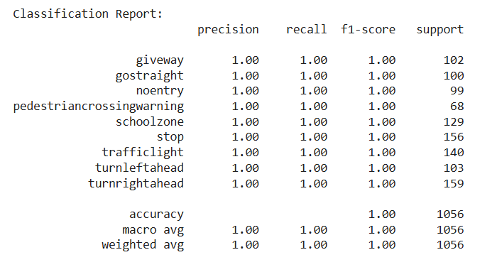
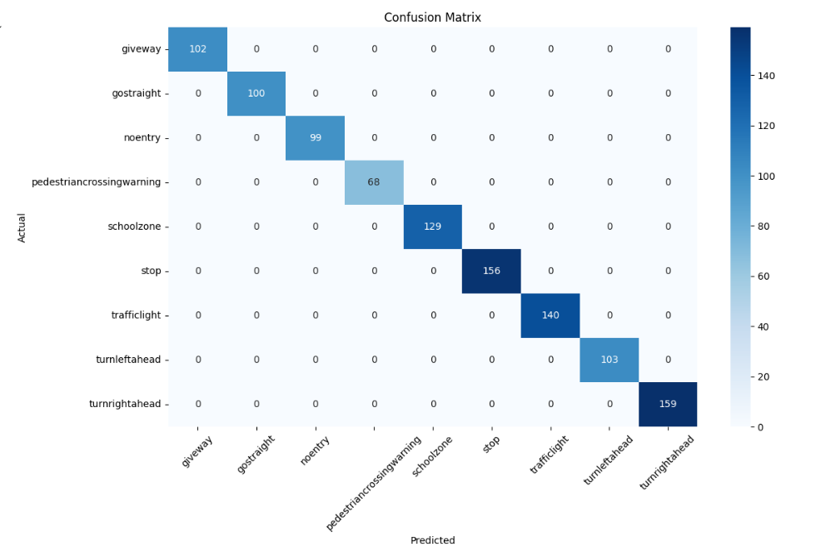
Work Completed

Slide 23
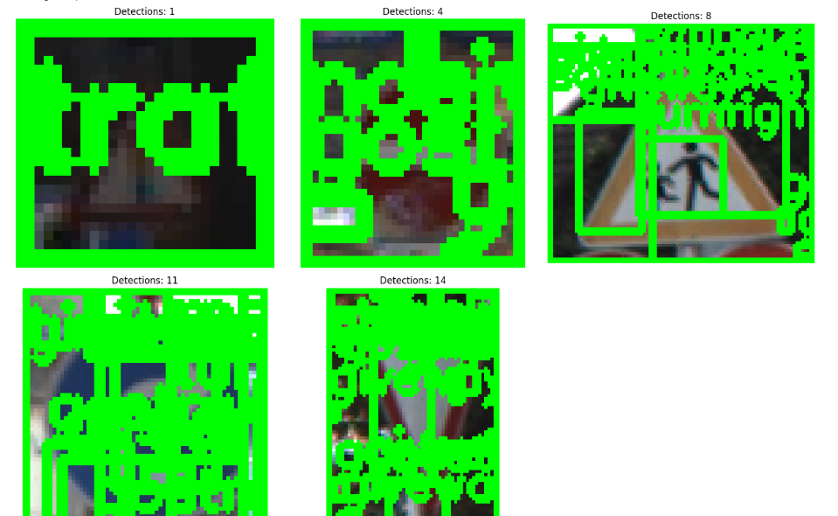
Work Completed

Slide 24
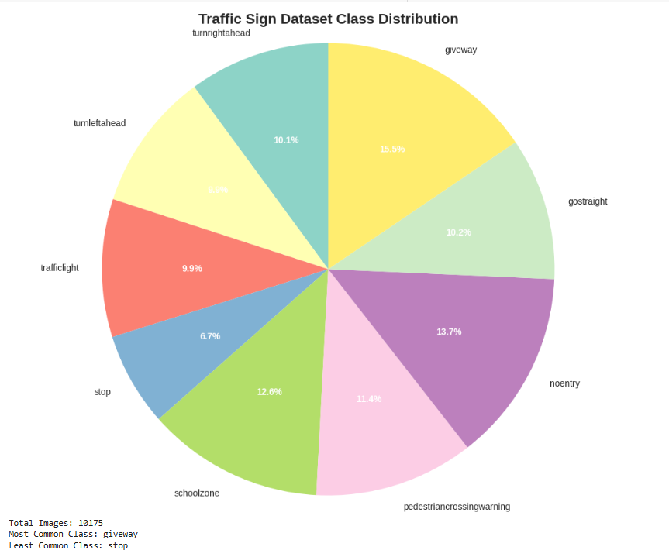
Work Completed

Slide 25
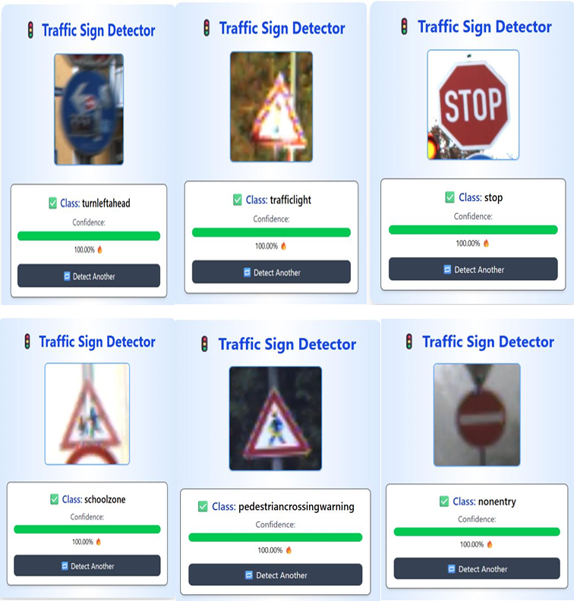
Output

Slide 26
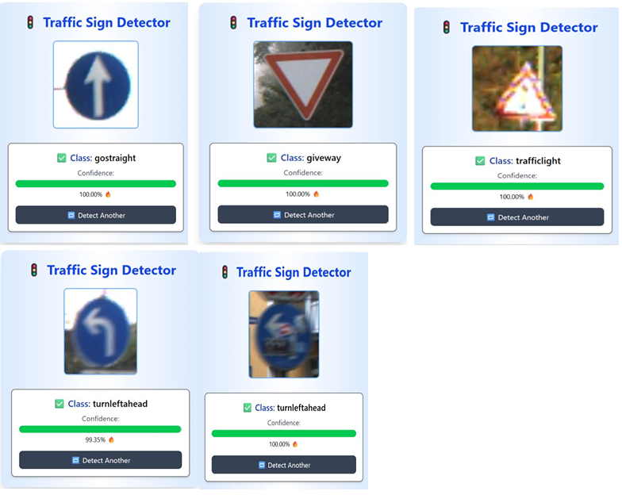
Output

Slide 27
Thank You!

